Slide 1
“AnimalScienceCraft” and “LearnCraft” Final Presentation
Austin Cory Bart
Eleonor Cayford
Dec 16, 2014 at Virginia Tech
Under advisement from Dr. Eli Tilevich

Slide 2
Quantifying Minecraft
17 million copies sold - Best selling PC game of all time
100 million registered users
One YouTube Minecraft channel: 150 million hits per month
>$100 million dollars for Notch, $2 billion buy-out by Microsoft
MineCon – 4500 tickets sold out in 2 hours
2,546,147 active forum members (minecraftforum.net)
1 developer -> 5 PC developers : HUGE COMMUNITY
Notes:
15 million copies sold, making it the 3rd most popular PC game of all time, behind The Sims (10 years older) and The Sims 2 (5 years older). More popular than World of Warcraft.

Slide 3
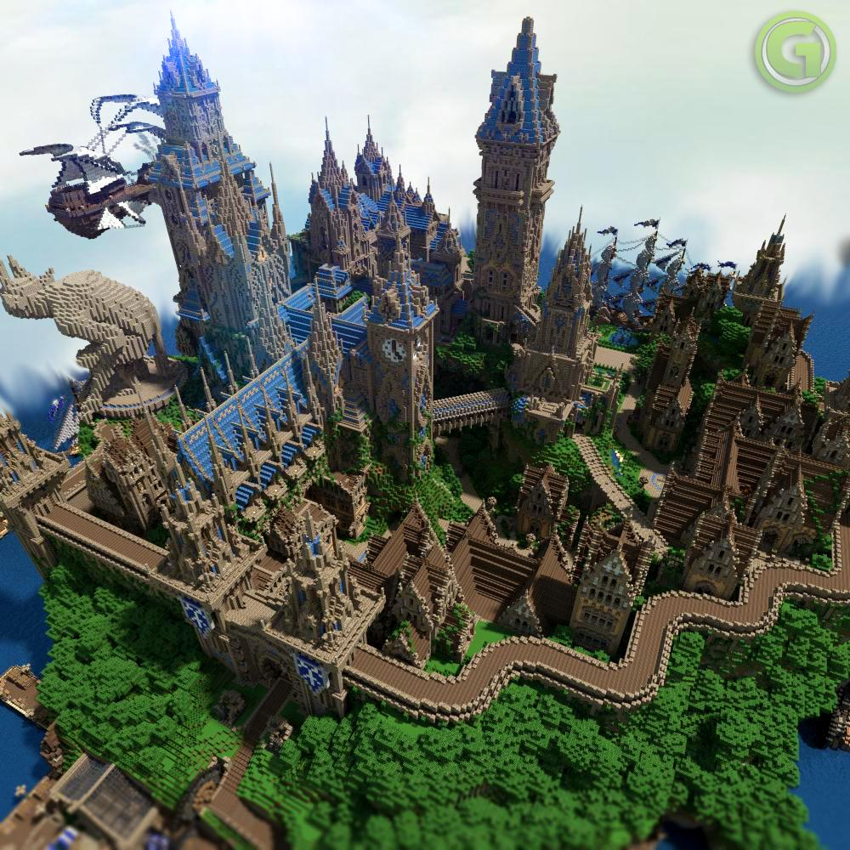
Halion
By Team Gazamo
1000+ hours
190 million blocks
5 person team

Slide 4

High Rossferry City
19 months
250 skyscrapers
2 person team
http://highrossferry.com/image/WM/HRFMW.html

Slide 5
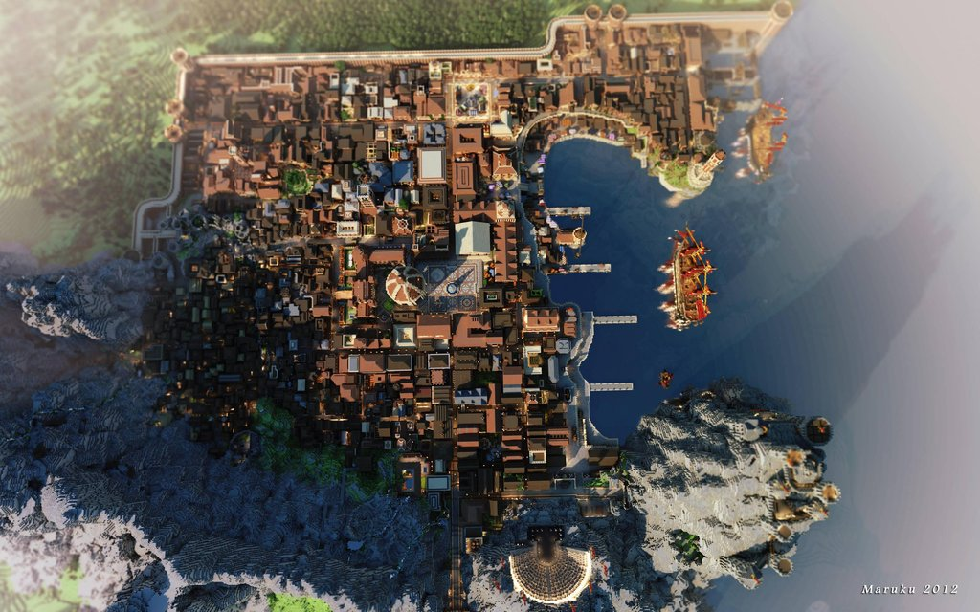
King’s Landing

Slide 6
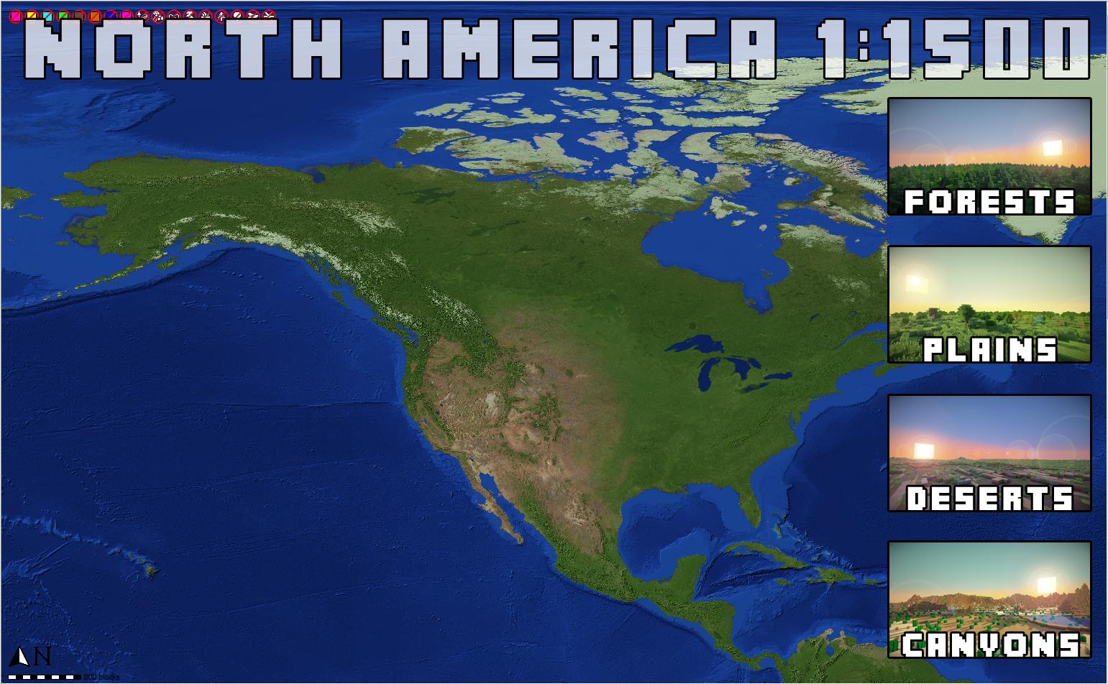

Slide 7
Let’s See Minecraft!
https://www.youtube.com/watch?v=lad5NzIwYq0

Slide 8
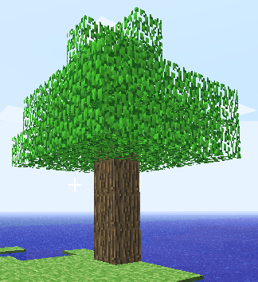
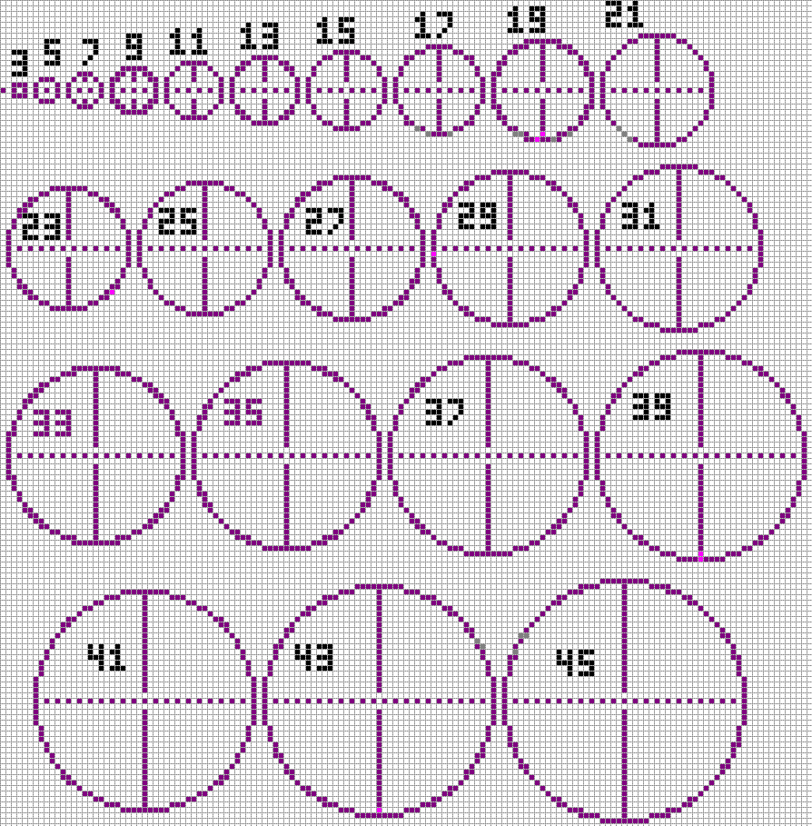
“Learn the game”

Slide 9
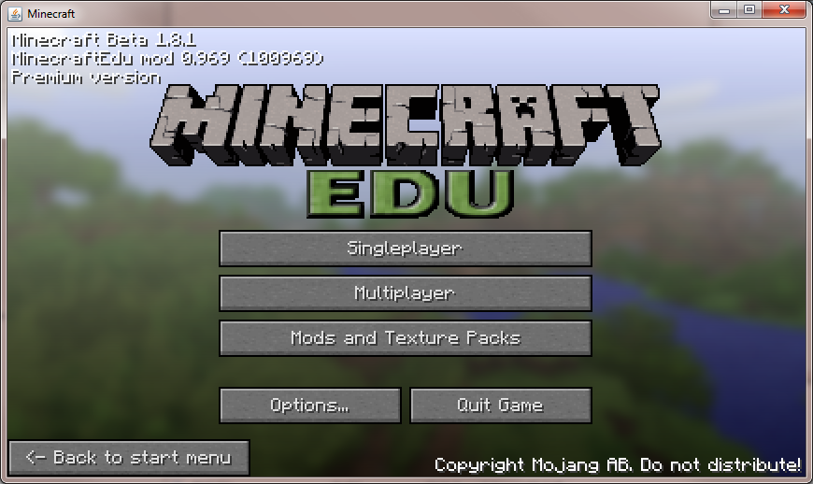
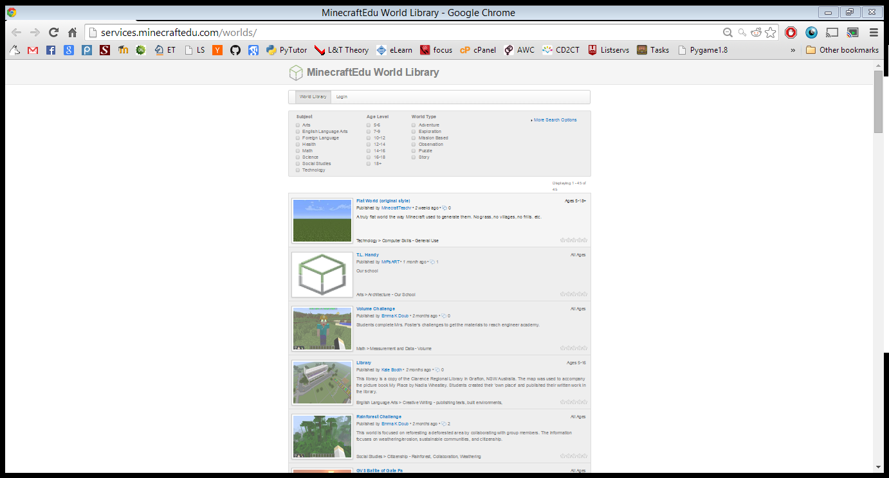
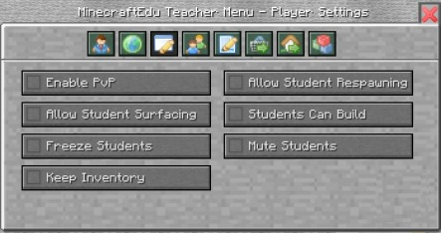
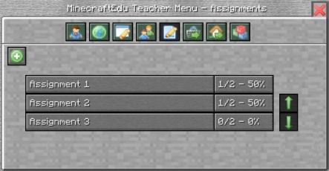

Slide 10
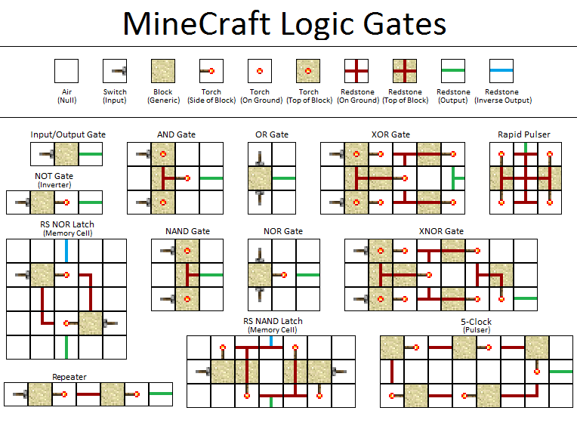
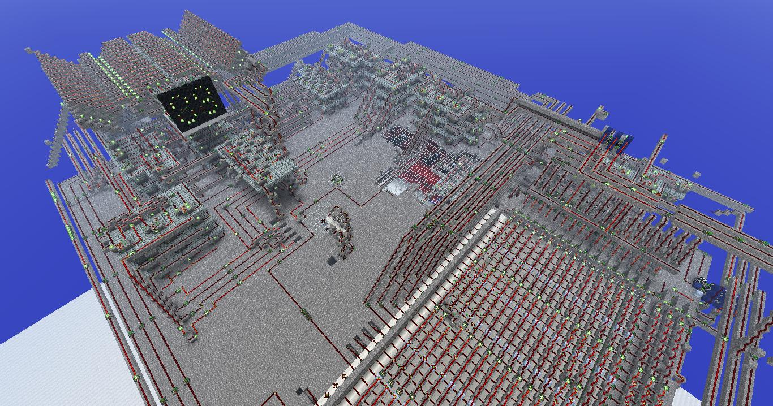
Computer Engineering 101: Redstone

Slide 11
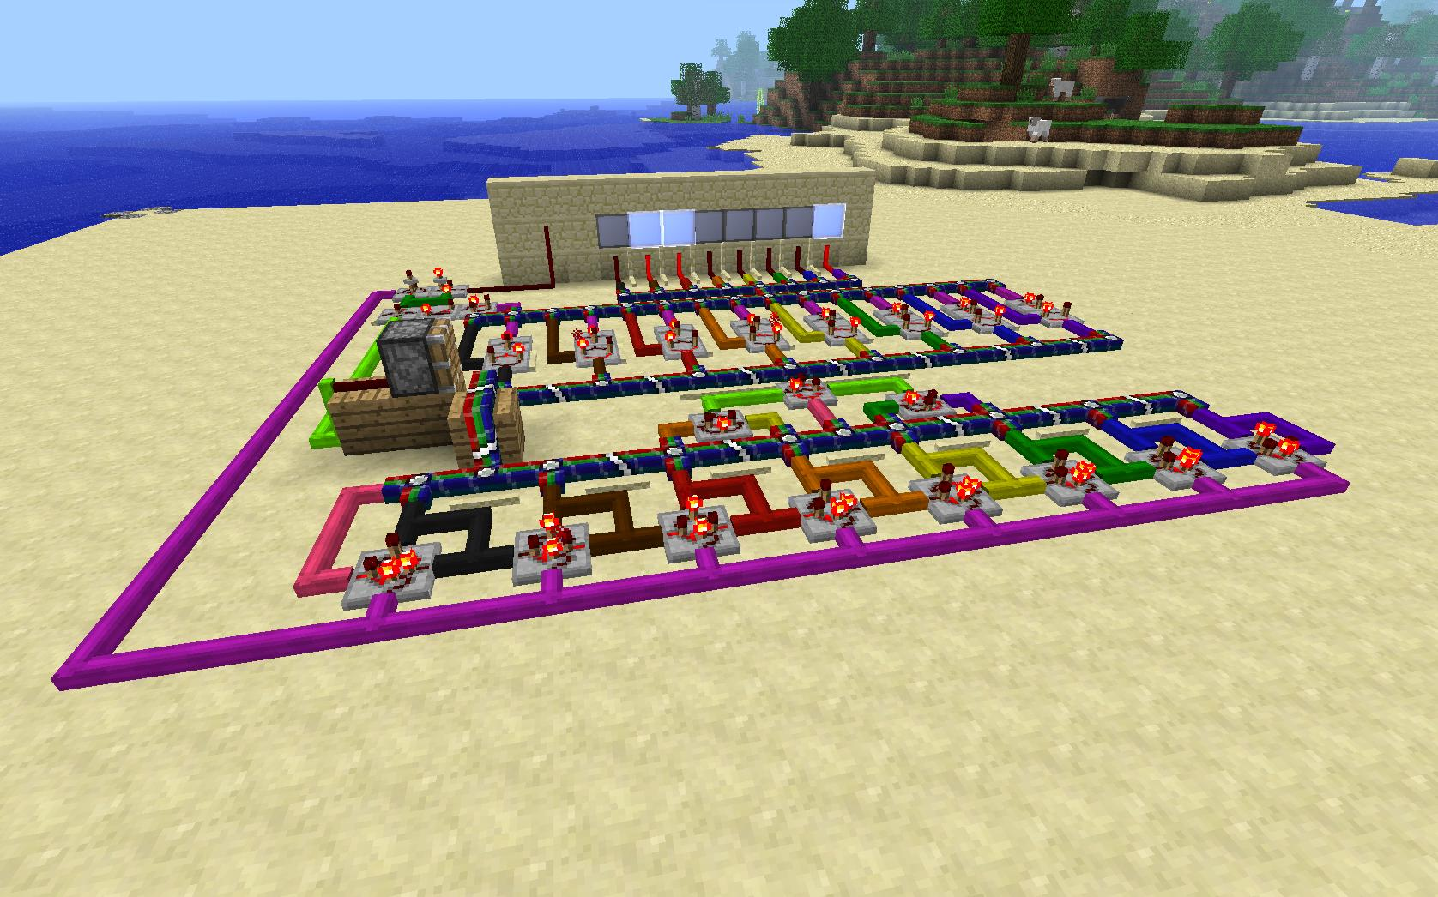
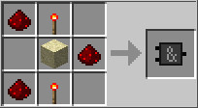
RedPower + Technic: Cpeg 102

Slide 12
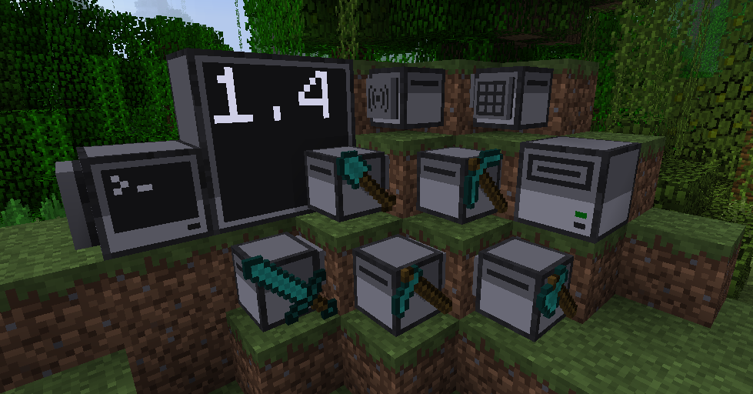
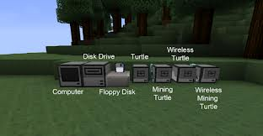
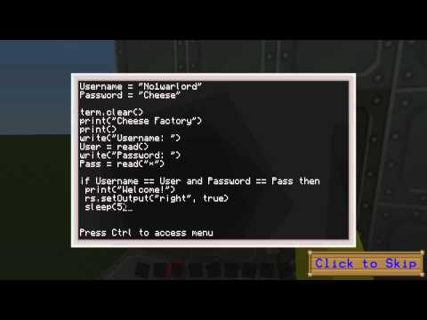
ComputerCraft

Slide 13
My Contribution
LearnCraft
In-game tutorial and reference
Timed to events
AnimalScienceCraft
More accurate animal science
More useful animals

Slide 14
LearnCraft: Changes
Tutorials and References
Arbitrarily nested content
Navigation
Rich media (unfinished)
Timed to events in game

Slide 15
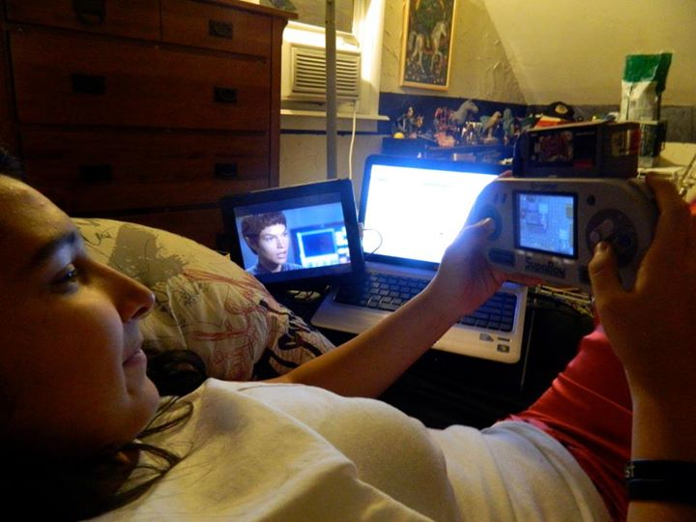
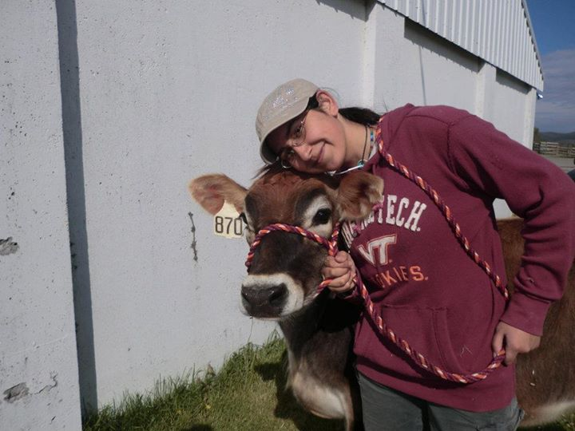
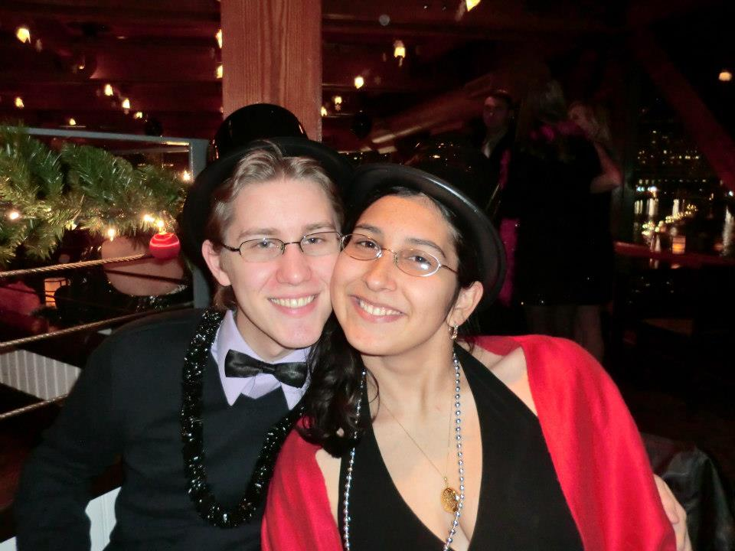
Eleonor Cayford Animal science expert
Junior in Animal and Dairy Science
Avid Gamer
Budding programmer
Amazing girlfriend

Slide 16
Animal Science Minecraft mod
“Why are animals so useless?”
“These animals are so unrealistic!”
Endogenous Gameplay changes

Slide 17
Audience
Middle School +
Both genders
Formal and Informal

Slide 18
ASC: Changes
Gender, Estrous, Automatic Breeding
More accurate model
Genetic Traits – Feed Efficiency, Potential for Production
Incest blocking – Lineage is tracked across three generations
New drops
New sedentary behavior
Hunger for animals
Stress

Slide 19


Learning objectives
Livestock - FFA
Companion Animals – Shelters

Slide 20
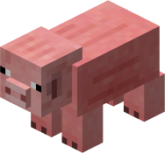

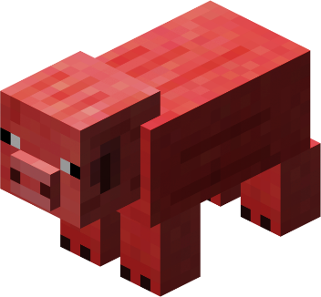
AS.02.01.01.c. Classify animals according to the taxonomical classification system.
Piglet
Birthed - Sow
Swine
Virgin - Gilt
Castrated - Barrow
Uncastrated - Boar

Slide 21
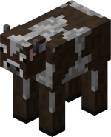
AS.02.03.01.c. Evaluate and select animals to maximize performance based on anatomical and physiological characteristics that affect health, growth and reproduction.
Amy (Heifer)
Age: 2 days
Father: Troy
Mother: Velvet
Children:
Traits:
Domestication: 5
Milk Production: 7
Meat Production 2
Feed Efficiency: 7
None
Status:
Hunger:
Stress:
Estrus:
6
1
210
Affinities
Okay

Slide 22
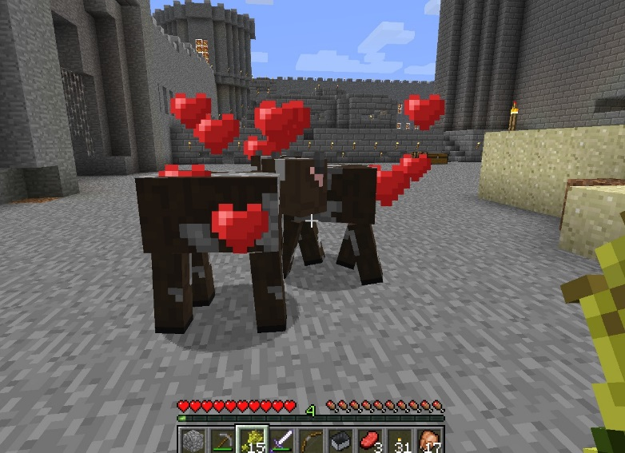

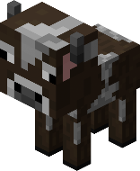
AS.05.03. Apply scientific principles in the selection and breeding of animals.
Original Minecraft

Slide 23
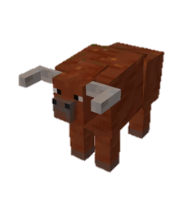



AS.05.03. Apply scientific principles in the selection and breeding of animals.
Estrus
“Genetics”
Modded Minecraft

Slide 24
Minecraft forge
Event system using annotations
Managers
Mod skeleton
Extend, reimplement, but can’t really modify

Slide 25
Biggest challenges
Obfuscated identifiers
Little to no documentation
“How do I make it jump?”
Constantly reacting to API changes

Slide 26
Better callgraph analysis
public static final int field_i_4344a = 47;
...
fontRenderObj.drawString(field_i_4344a, 32, “Hello”);
Known parameter “X”
Only use of this constant
Document field as involving “X”

Slide 27
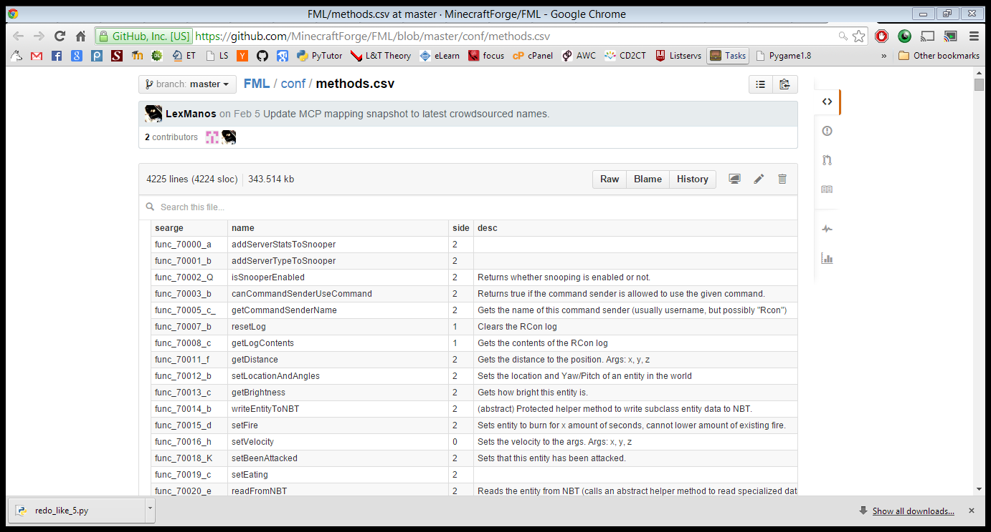
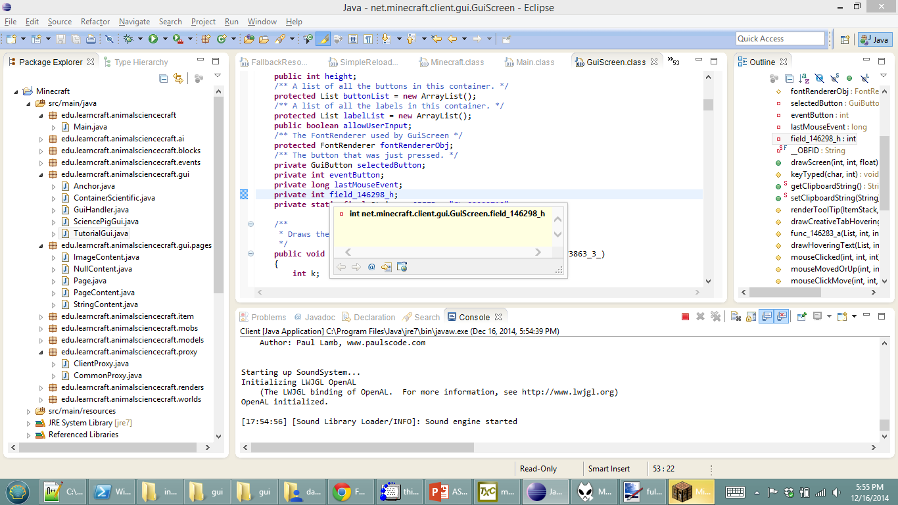
Crazy idea: Crowd-sourcing plugin
Community documentation: This field seems to be related to schema for
Edit Community Docs

Slide 28
Future Directions
LearnCraft+
Nuclear materials handling
ComputerCraft
RedPower (Digital Logic)
..
AnimalScienceCraft
More animals
More features (affinities, items, villager trading)

Slide 29
Future Funding
ICAT Funds projects like this
Strong positive endorsement from Dr. Michael Evans
Hire an undergraduate
Partner with Animal Science Professors

Slide 30
Future PUblications
Animal Science Education
Their biggest problem is motivation – making AS fun
Digitally Mediated Learning
Very hot subfield in Education – this is a perfect example of what they like
Computer Science
Teaching CS with Minecraft – ComputerCraft, Modding
Refactoring Deobfuscated codebases (JavaScript)

